Slide 1

Recommendation System
Applied Data Analysis - Final Project
Cnet ID: krishnaveni
UCID: 12374512

Slide 2

Problem Space: The Information Age
Internet brings the Age of Information Explosion
Increasing brand rivalry
Increasing need to build customer loyalty
Information Overload
Over Choice
Need for marketing strategies to increase sales and revenue
“Customers seek brands which align with their personal values and beliefs”

Slide 3

Solution and its Advancements
Customized products
Targeted Marketing
Acknowledge customer behaviours and personalities
Build solutions which are at the crux of Personality Psychology and Economics
“Better access to more product options has made brand loyalty less secure”

Slide 4
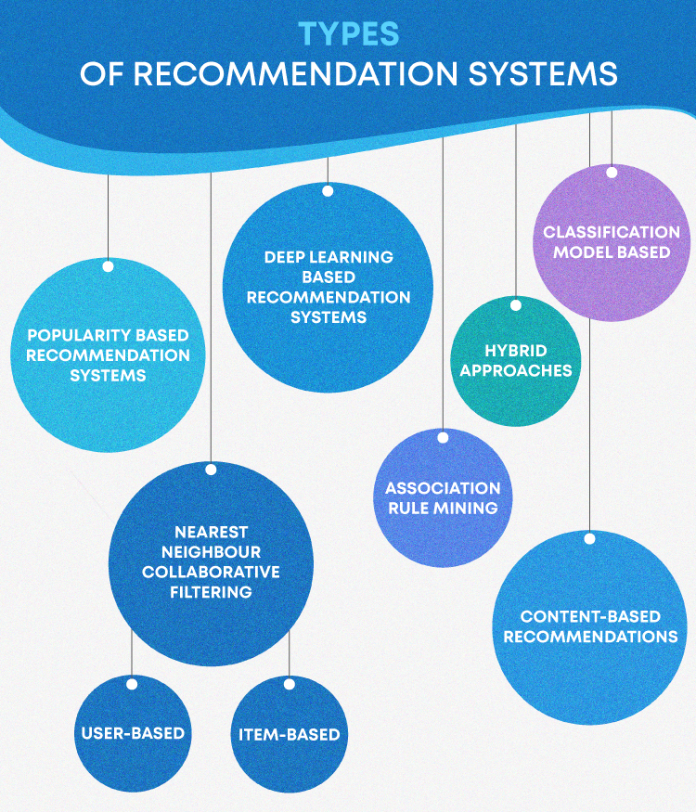
Recommendation Systems
Evolution of Models:
Item Hierarchy
Attribute Based
Statistical Models
Matrix Factorization
Formulae Based
Model implemented:
Content Based System
Model Based Recommendation Systems
Model implemented:
Collaborative Filtering

Slide 5

Implementation Details…..
Dataset
Curse of Dimensionality
Models
Content-Based Filtering
Model description
Performance
Challenges
Collaborative Filtering
Model description
Data Augmentation
Performance
Challenges
Platform Support
Resources & References

Slide 6

Dataset Details
Movie Lens 20M dataset
Data:
Movies
Users
Ratings
Timestamp
Genres
Year of Release
Data Augmentation: The Why?
Used: 7M data points
Tested on: 14k users

Slide 7
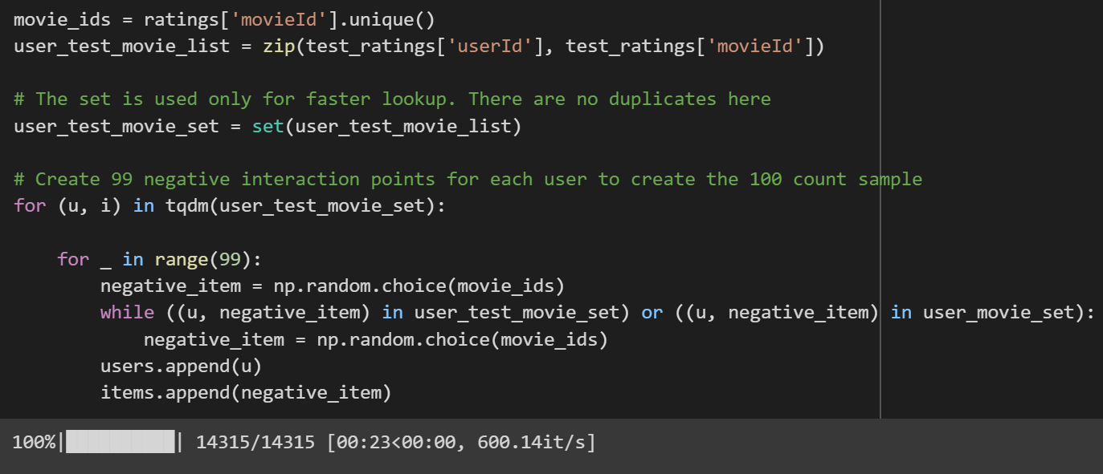

Slide 8

Content Based Recommendation System
Item-Item similarity
Thematically linked items
Meta-data of the items
Cosine similarity
Use of rating to measure relevance
Statistical Model
Results:

Slide 9
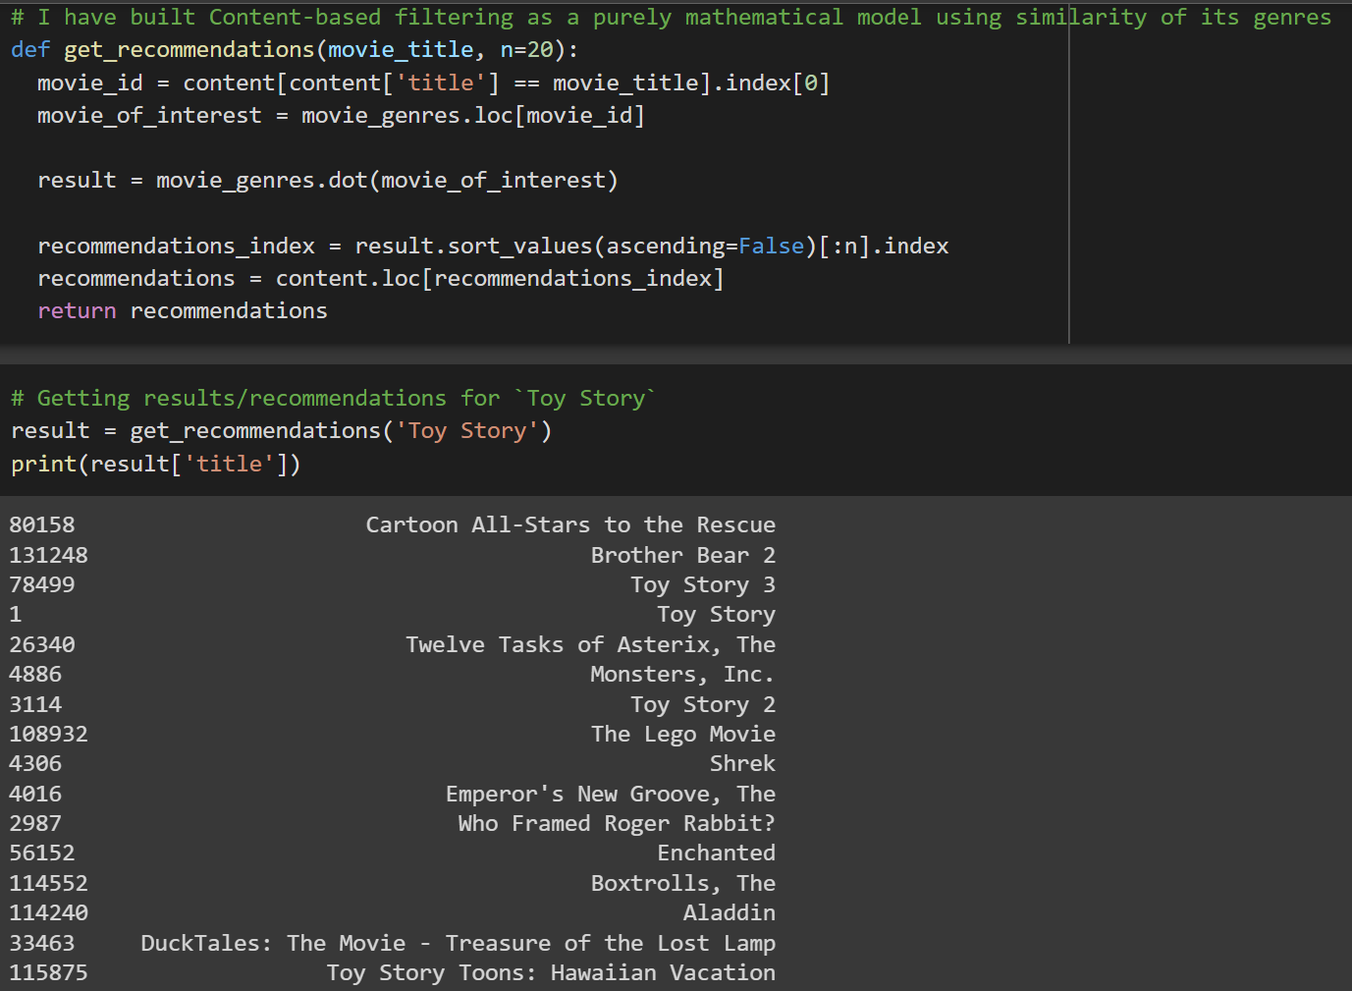


Slide 10

Collaborative Filtering Model
Based on user-item interactions
Ratings
Neural Collaborative Filtering model
Implicit Feedback
Tower structure
Activation: Relu
Optimizer: Adam
Loss function: Log Loss
Improvements: Diversity regularizer
Metric: Hit Ratio@10
Result:

Slide 11
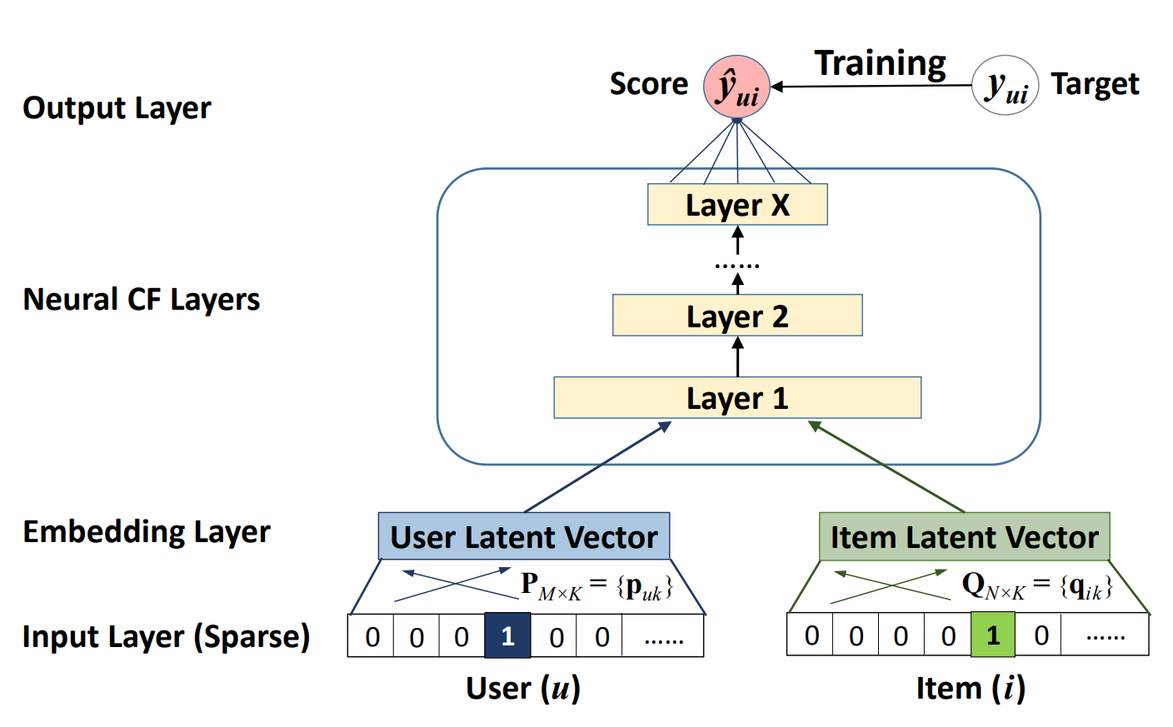
Neural Collaborative Filtering

Slide 12
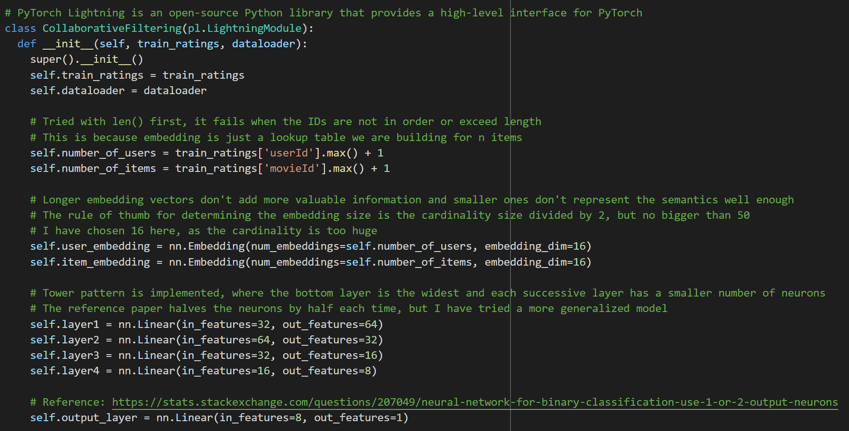

Slide 13
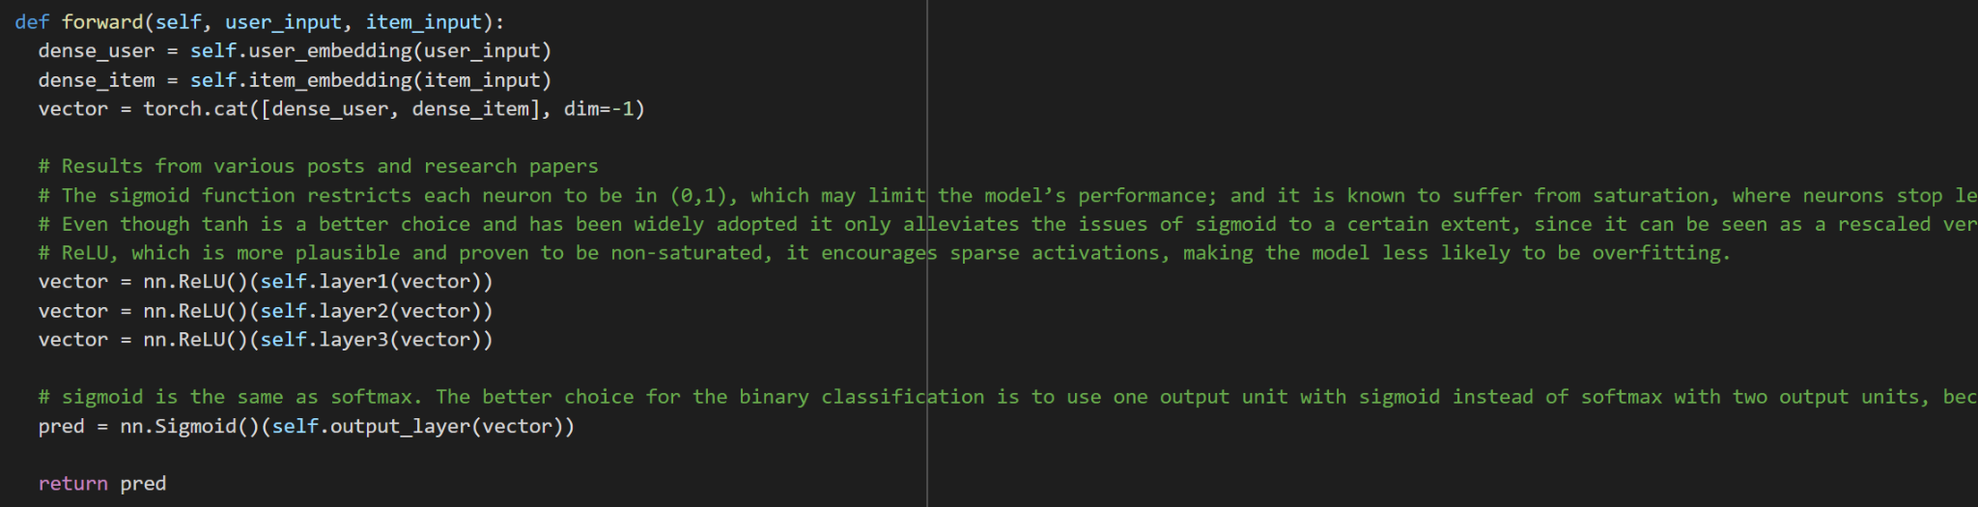
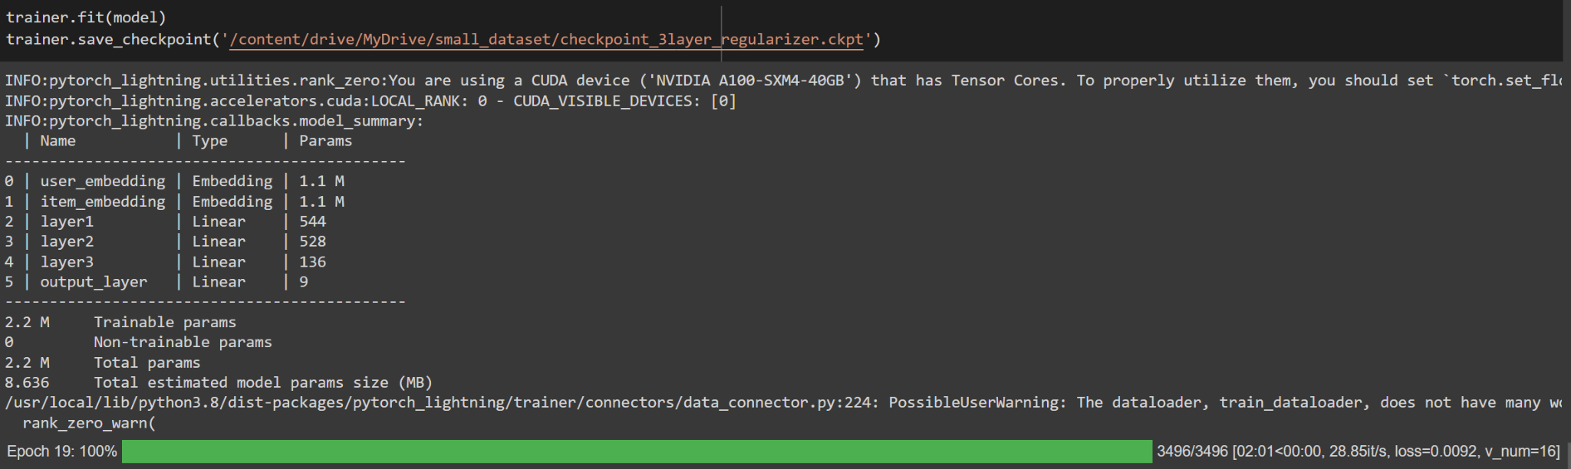

Slide 14
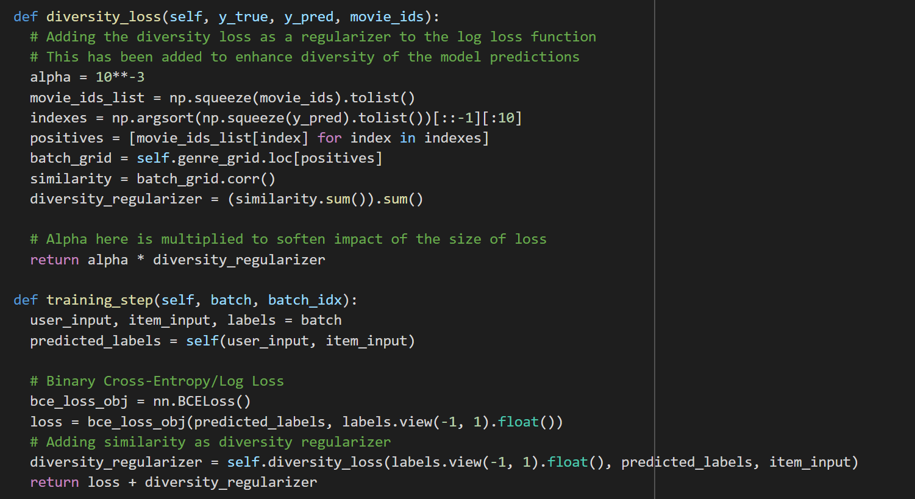

Slide 15
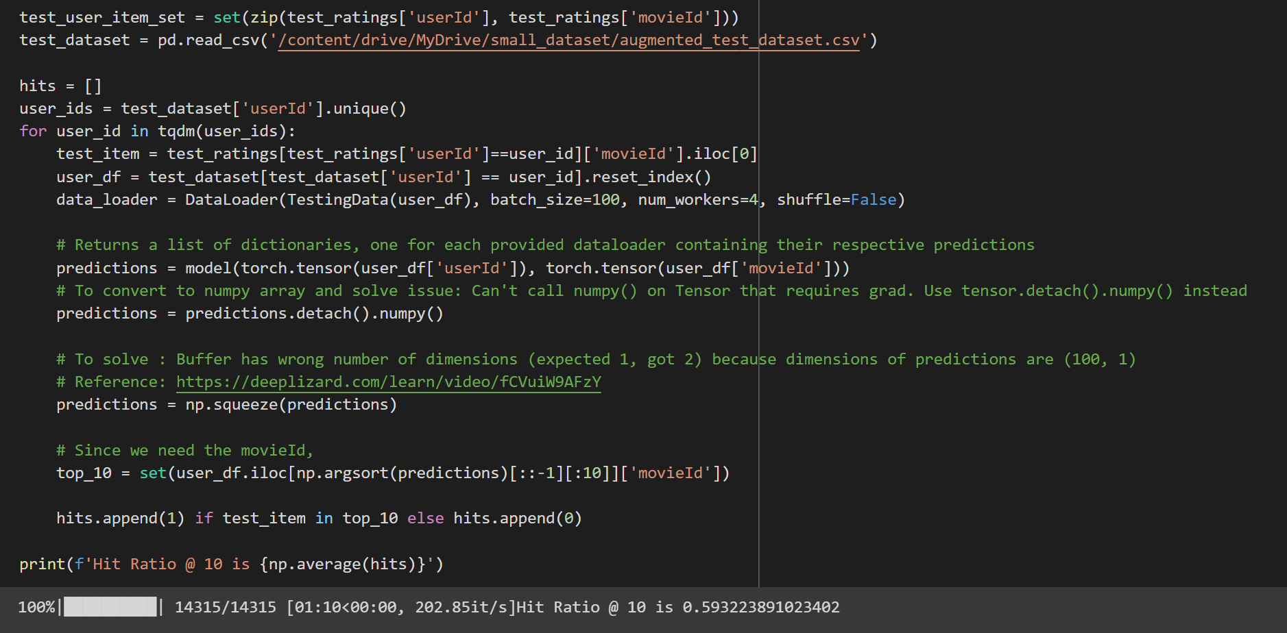

Slide 16

Results…
Without Regularization
3 hidden layers: 0.524
4 hidden layers: 0.593
Benchmark from Research Paper: 0.67
With Regularization
3 hidden layers with regularization: 0.57
Improvements:
More Data
Resources
Compute
Memory
Time Taken for each epoch
Optimization of Custom loss

Slide 17

Challenges and Future Scope
Challenges
Changing user preferences
Choosing an architecture
Curse of Dimensionality
Platform availability
Tuning of Hyperparameters
Space and Time Constraints
Future Scope
Deep Learning model for Content-Based Filtering
Tune hyper parameters
Improve diversity regularization
Implement the NeuMF model
Session-based recommendations

Slide 18
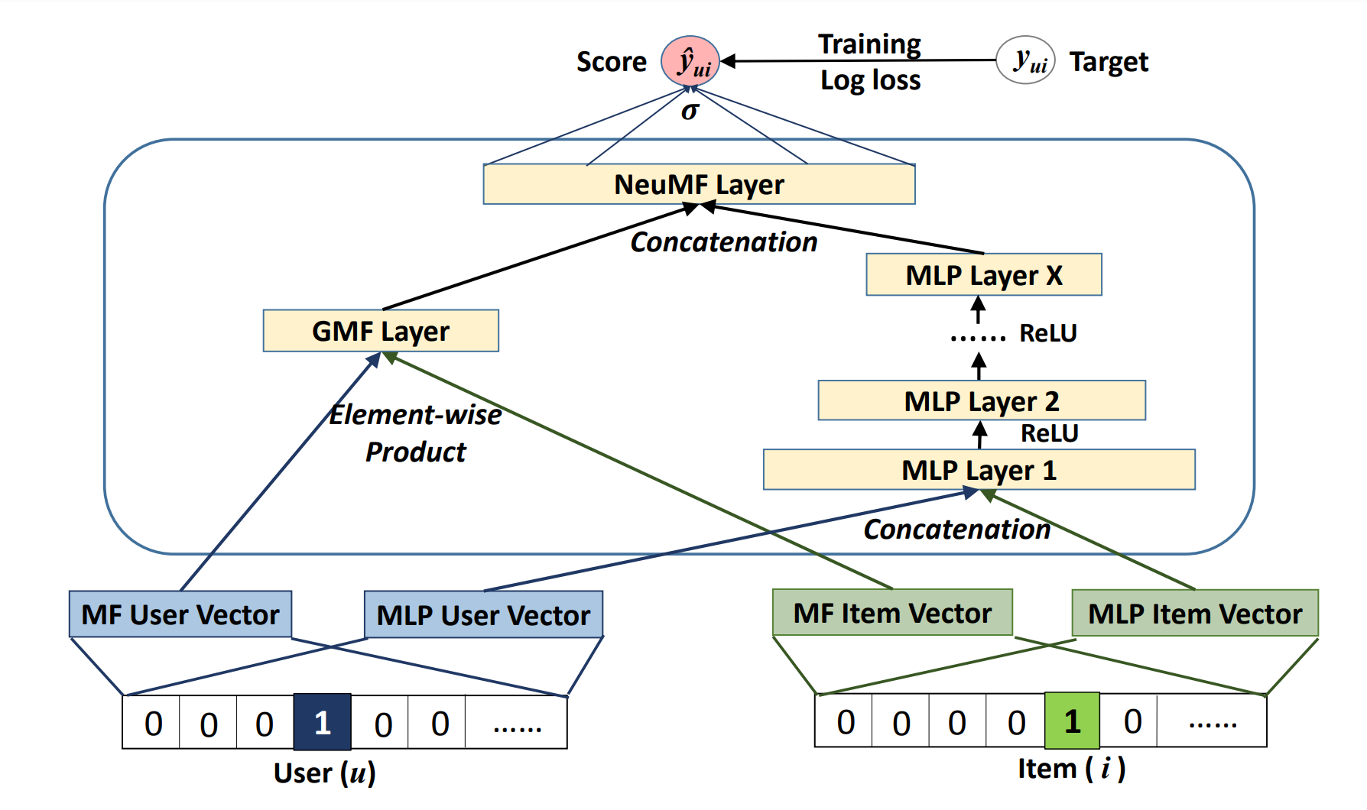
Neural Matrix Factorization

Slide 19

Learning Journey…
Understanding of Recommendation Systems: The secret sauce
Know-how of various advancements
Deep learning fundamentals
Data Augmentation
Model development
Pytorch and Pytorch-lightning
Trade-offs between activation functions and optimizers
Troubleshooting
Experimentation

Slide 20

THANK YOU!

